Slide 1
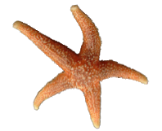
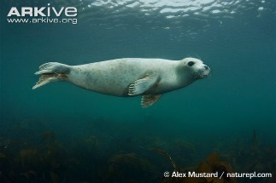
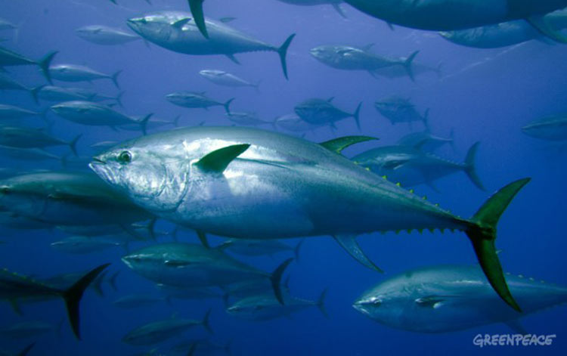
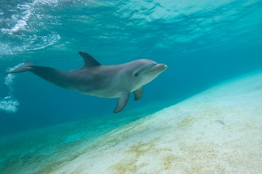
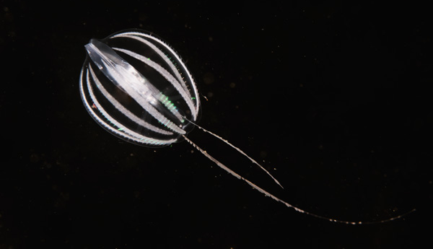
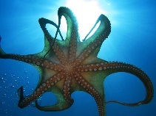
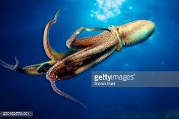
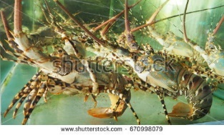
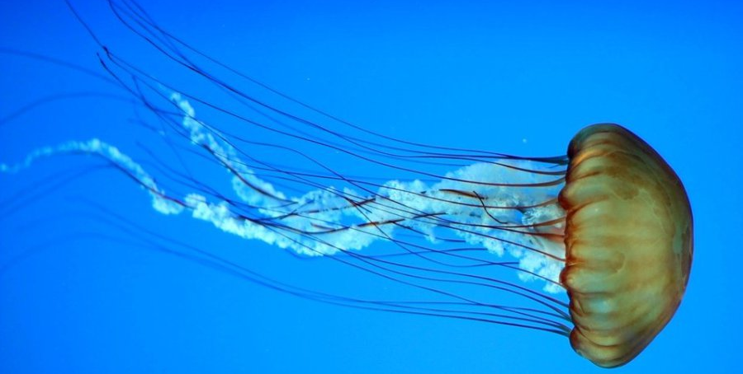
Examples: worksheet propel in water
Seals: They swim by pressing their front flippers tightly against their body and moving their rear flippers to turn left and right. If they swim slowly, they use their front flippers to maintain balance.
• Agila and also on land
Bleufin tuna: These fish swim by moving their tail fin from left to right. Their front fins serve for balance. What is special is that they swim very closely together in a plaice for protection. For this they have developed senses through which they can adjust the direction and speed of themselves to the fish around them
• Make use of the swirls of the water
Dolphins: They swim by moving their tail fin up and down.
• Pull a fast sprint
• Can jump in the water
Rib jelly: This animal has eight vertical ribs with swimming places. These swim plates consist of small cilia. By rhythmically moving these cilia, it can swim.
• Can keep itself upright whilst swimming
Octopus: It moves by a pulse-like movement. The tentacles spread horizontally. After which they bring the tentacles together, with the result that they make a forward movement.
• A lot of power in one go
• Maneuverability
Lobster: They swim by pulling their tail in and then relaxing again.
• Swim backwards
Jellyfish: They mainly use the currents with which they drift. They can often still move a little bit themselves by making a fluffy movement.
• Energy efficient

Slide 2
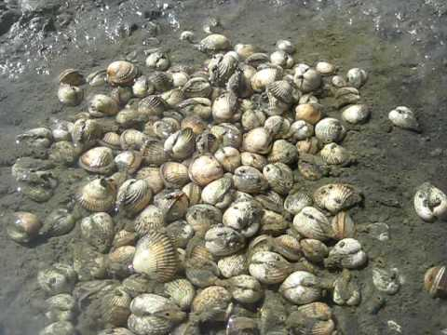
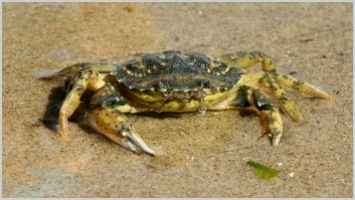
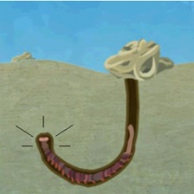
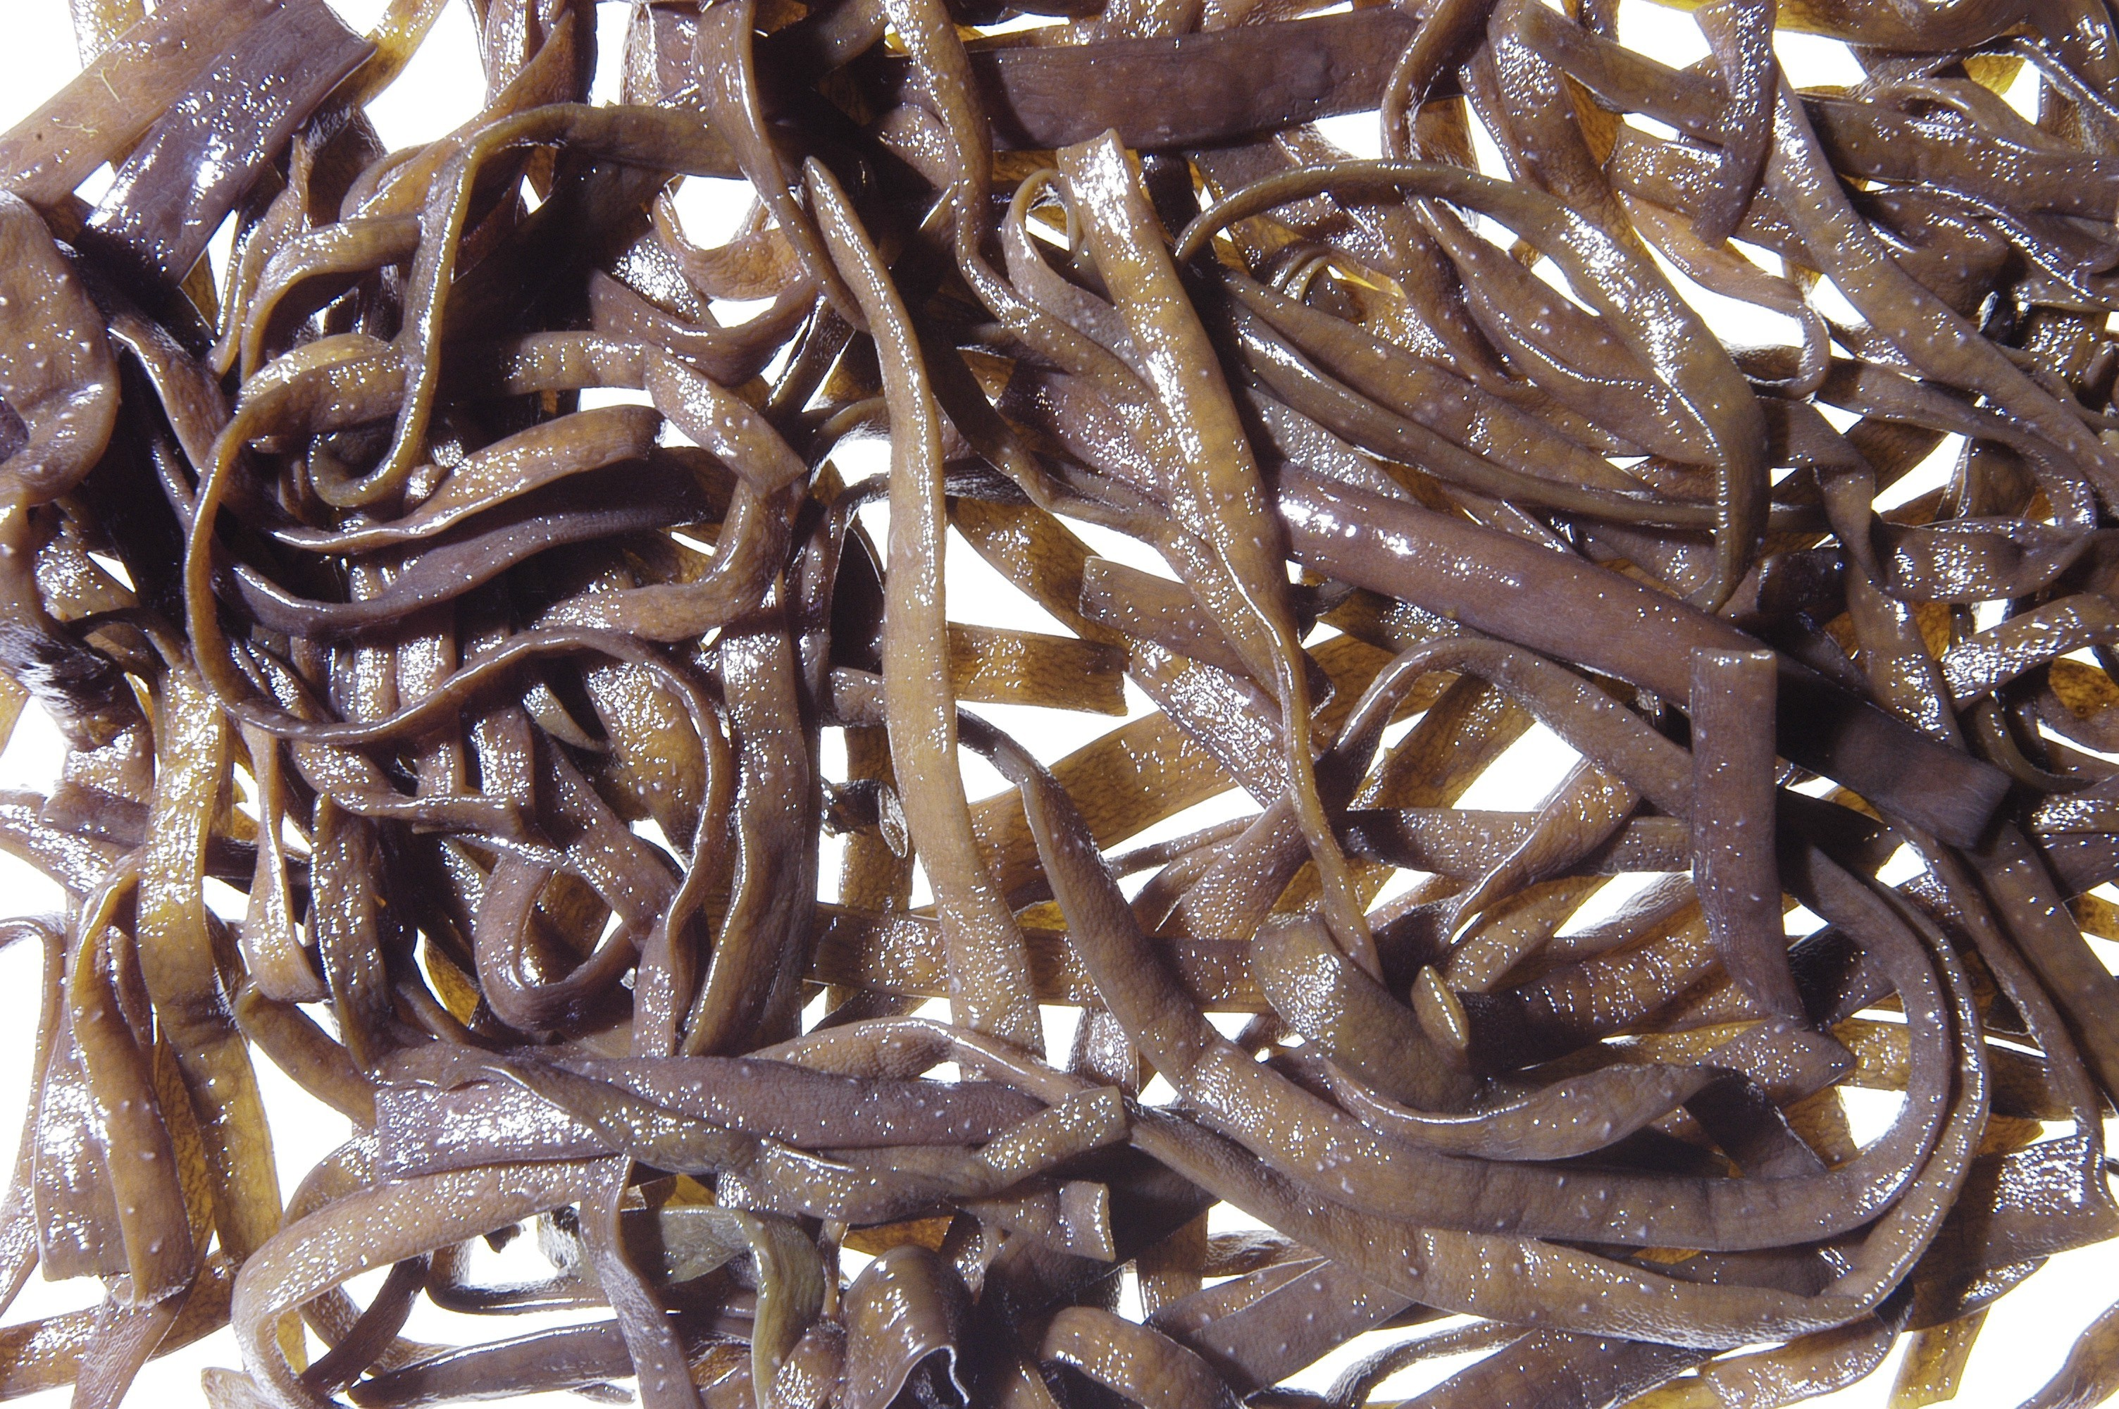
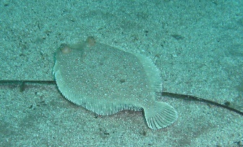
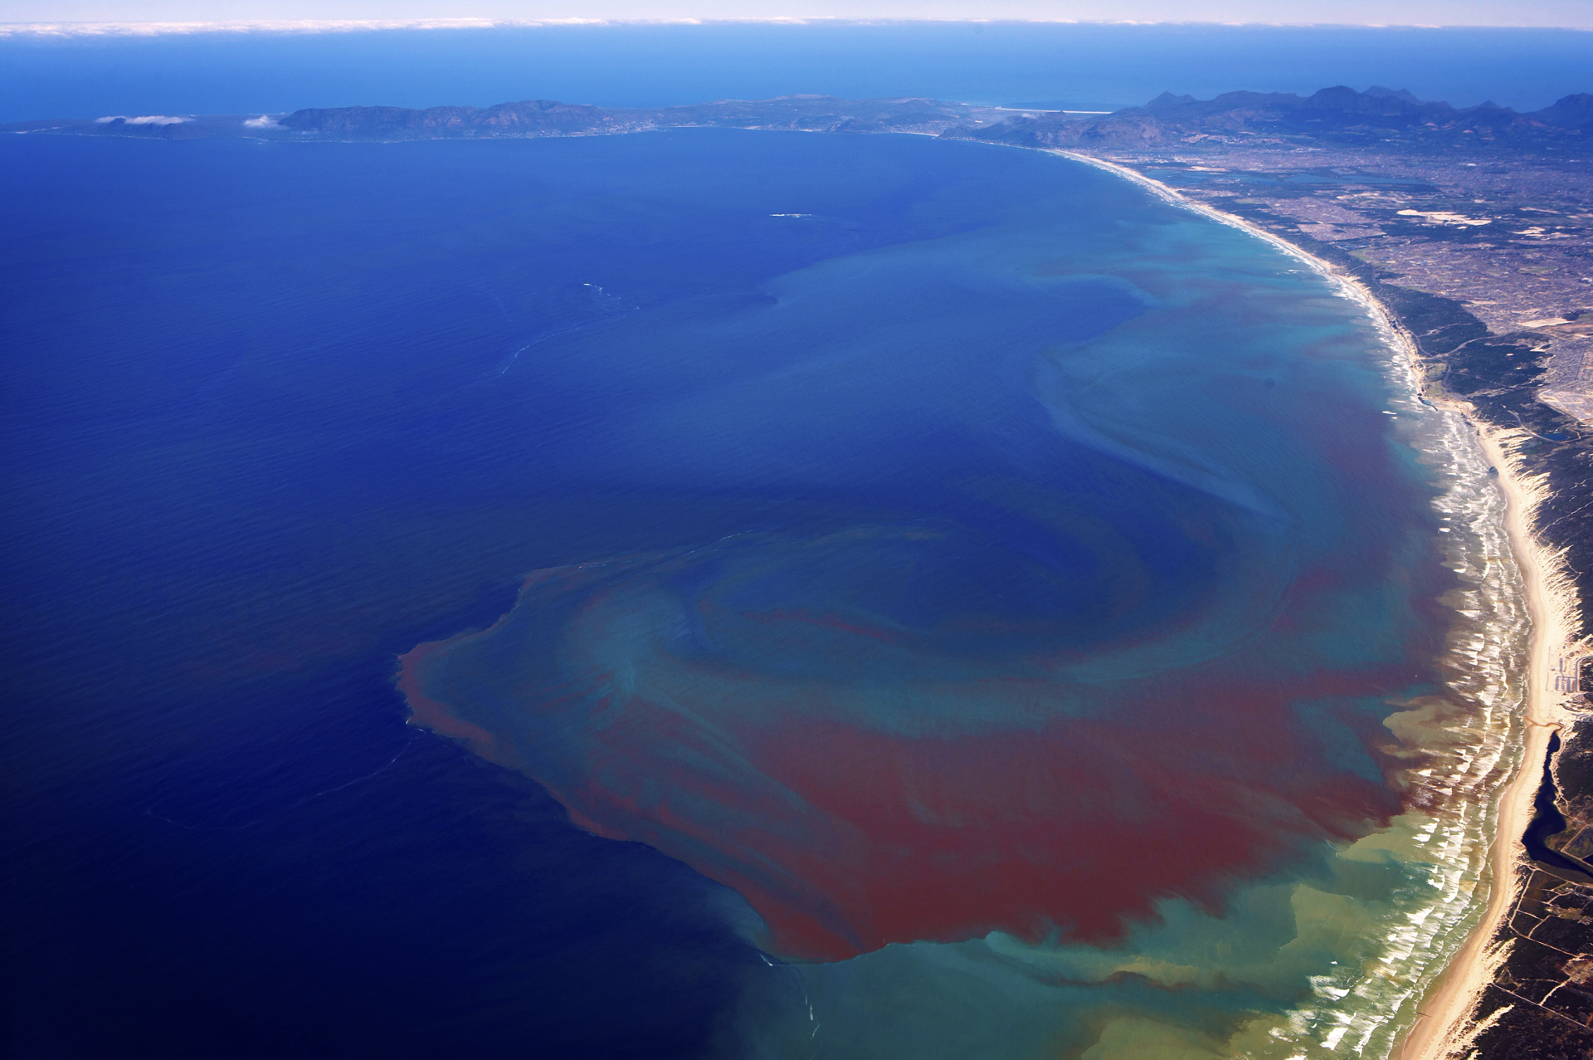
Examples: worksheet climate proof building
Cockles:
Can close their shells so they can catch water inside and keep breathing.
Can dig themselves into the ground allowing them to survive extreme weather conditions.
Their shells are hard so that the incoming waves and the birds cannot destroy them quickly.
Crabs:
Have a thick armor which makes them dry out less quickly.
Dig themselves into the ground so they can survive extreme weather conditions.
They can walk, so they can look up small pools of water.
Mudflat:
It lives 25 cm below ground so that it can handle the extreme weather conditions.
They can adjust their metabolism as the temperature rises, allowing them to survive for a while with anaerobic processes (without oxygen).
Seaweed:
Move with the wave.
Made of sturdy material that they do not break down quickly.
Are attached to stone or shell.
Flatfish:
Can not fall dry, but because it is flat it can survive in very shallow waters.
It can bury itself temporarily.
Algae:
Float along with the currents of the sea.
Can sometimes link together to form larger organisms.
Grow quickly in water that is rich in nutrient nutrients.

