Slide 1
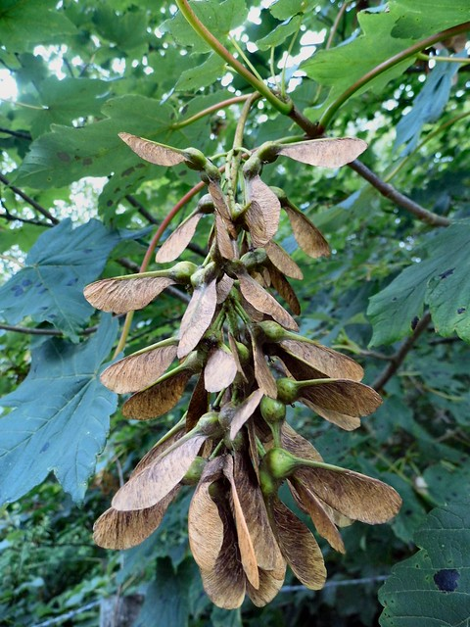
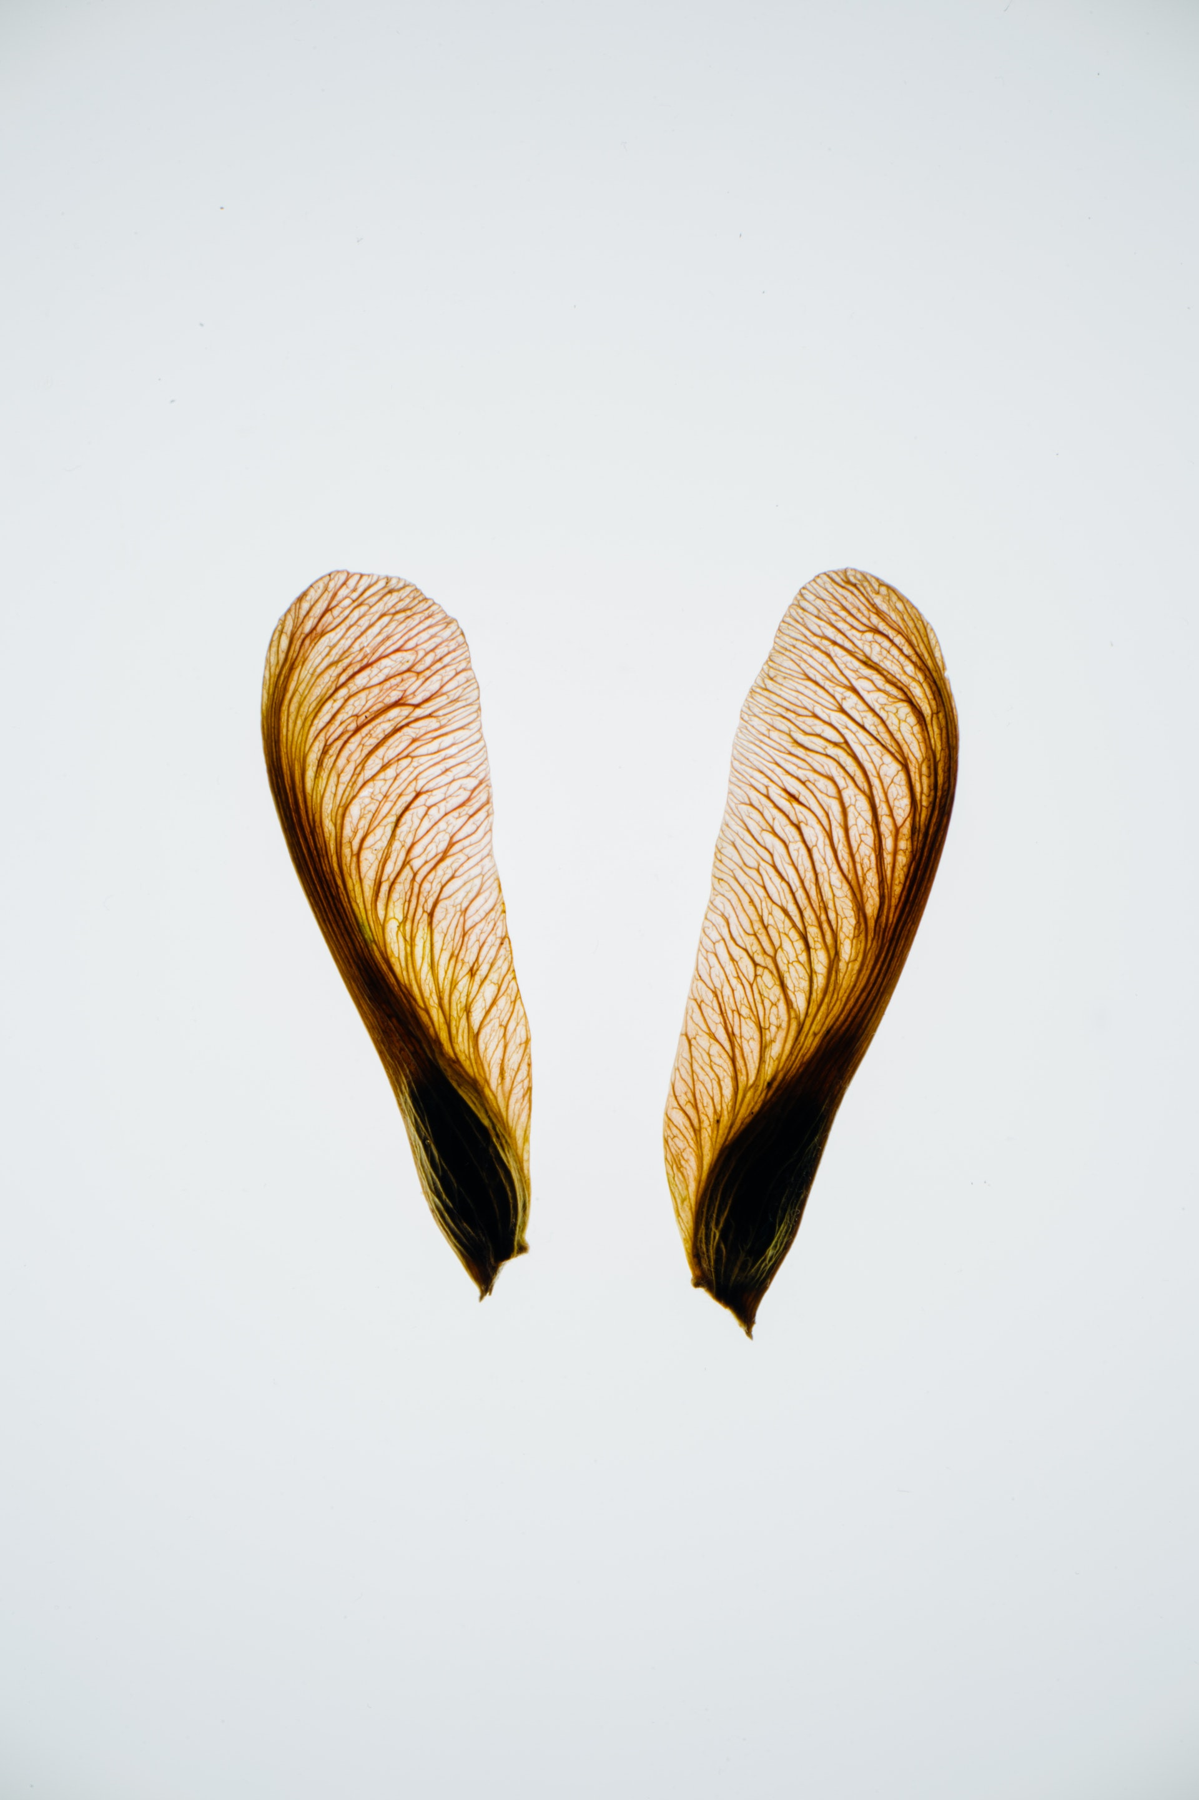
Seed Design Task

Slide 2
What can we learn from a seed?
Challenge: watch this video about the flight of a falling maple seed

Slide 3
What can we learn from a seed?
In your group of 2 or 3, you have one sycamore seed.
Spend 5 minutes looking at your seed and analysing its movement and structure in as much detail as possible. Use these points as a guide and be careful not to damage the seed
Examine the seed structure in detail.
Throw it in the air (sensibly!).
Look at how it flies – what allows it to move like this?
As you are doing this, try and think about why the seed has these features.

Slide 4
Can you make some observations about your seed? Use the prompt questions below to help you and answer the questions in your book (10 mins)
1. Describe its structure (e.g. shape/ size/weight)
Observations about our seed!
4. Describe its movement when you drop it from above your head
2. What do you notice about the fine details of the seed (when you look really closely)
3. What are the functions of the seed (e.g.what is the seed’s purpose?)
5. How might we be able to use these functions to solve real-life challenges?
Notes:
Potential for starburst activity here?

Slide 5
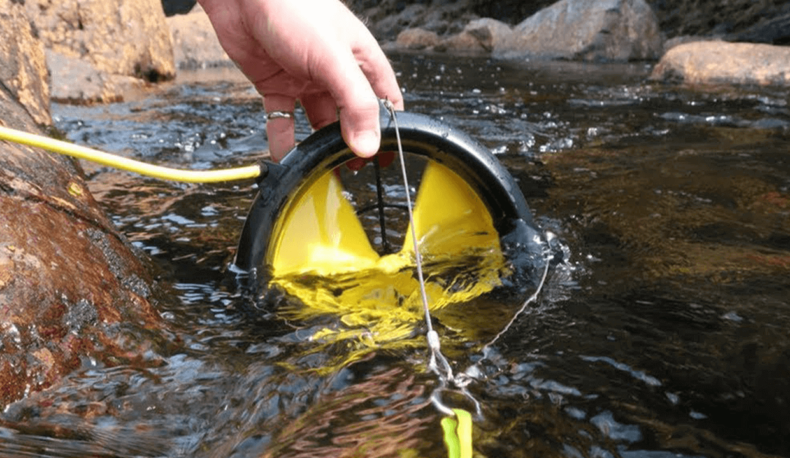
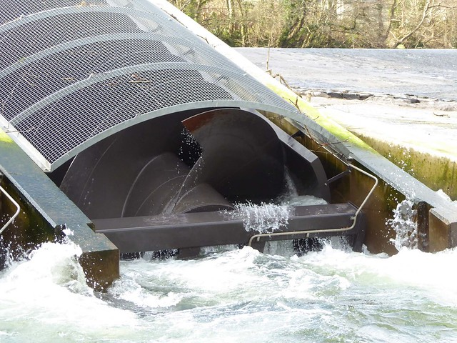
Some examples of how the design and function of the seed has been applied:
An Archimedes screw, such as at Totnes Weir hydro scheme) is used to generate electricity. This can also be used in reverse to pump water up-slope.

Slide 6
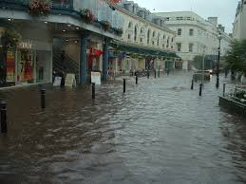
Mini-Design Challenge: We are now going to use the seed to help use solve a design challenge. The purpose of this is to help you to consider how looking to nature’s designs can help to prompt us to think and see differently – applying the ingenuity of the seed to a human design problem!
How can the design and function of the seed be copied to help people who are at risk of flooding?
Notes:
Mini-Design Challenge : Use the seed to help solve a design challenge (flooding). The purpose of this is to get students to consider how looking to nature’s designs can help to prompt us to think and see differently – applying the ingenuity of the seed to a human design problem.
The purpose of this is to get students to consider how looking to nature’s designs can help to prompt us to think and see differently – applying the ingenuity of the seed to a human design problem.
Students draw their design and label it with functions as observed in the previous activity making use of the 9 principles of biomimicry already given out to assess their design [W3.1].
Ask the students to consider how their design performs against the biomimicry principles – are there any which it is particularly strong at; are there any which are weak?

Slide 7
CLASS DISCUSSION:
Share ideas as a class.
Nominate one person from each group to share their biomimicry inspired design.
Answer these two questions in your presentation:
Which challenge did you choose to solve?
How did the sycamore seed inspire your design ?
Notes:
Extension: Students to share design ideas with the class (nominate one spokesperson)

